Slide 1
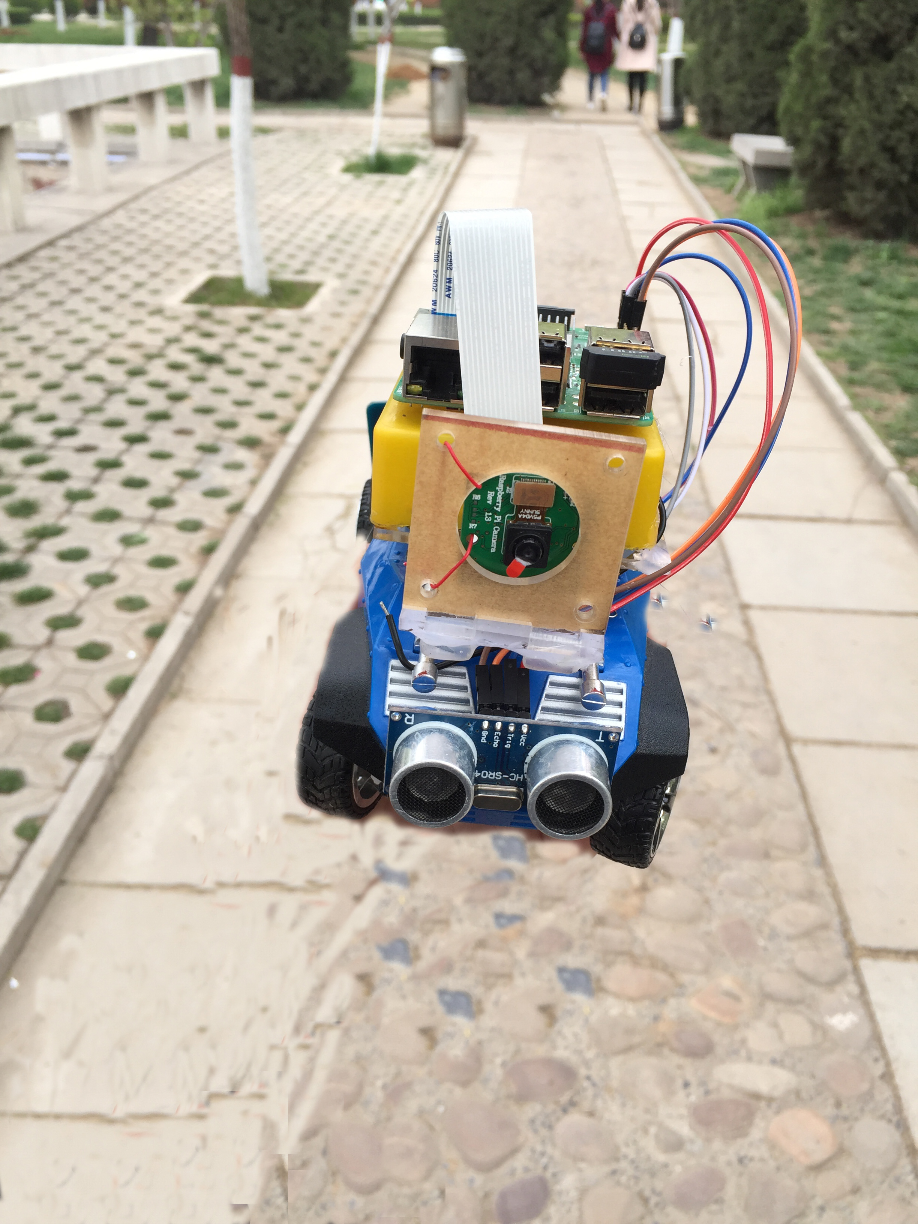
Self Driving RC Car
A remote control car that drives itself using OpenCV and neural networks
by Shine
Capstone Project with Deep Learning

Slide 2
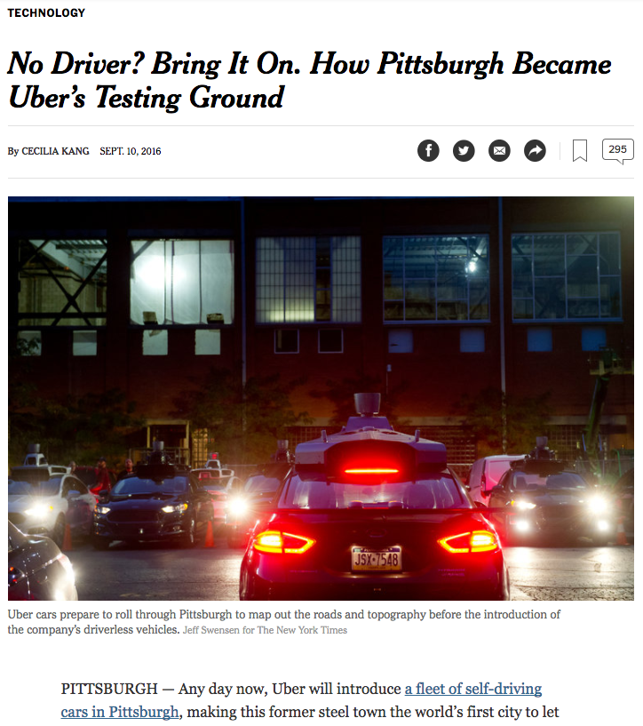
动机| Motivation
The New York Times, Sep 10, 2016
自动驾驶汽车已经在路上.
对公共政策的重大影响.
他们是如何工作的？
Notes:
You may have heard that self-driving cars are now on the road in certain cities, and as they become more fully implemented, they will have an increasing impact on our daily lives.
(CLICK) I’ve been interested in this field for a while now, and I wanted to learn more about the underlying machine learning techniques that make autonomous driving possible.

Slide 3
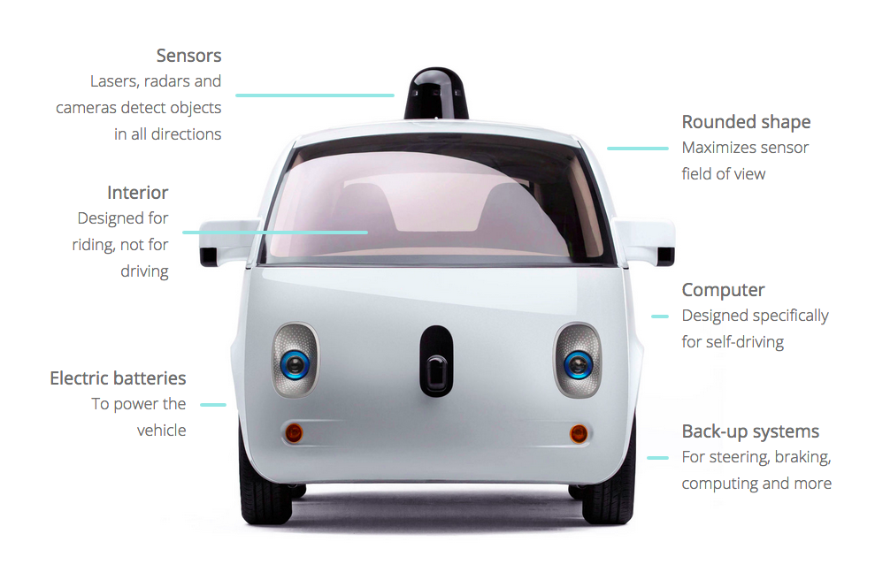
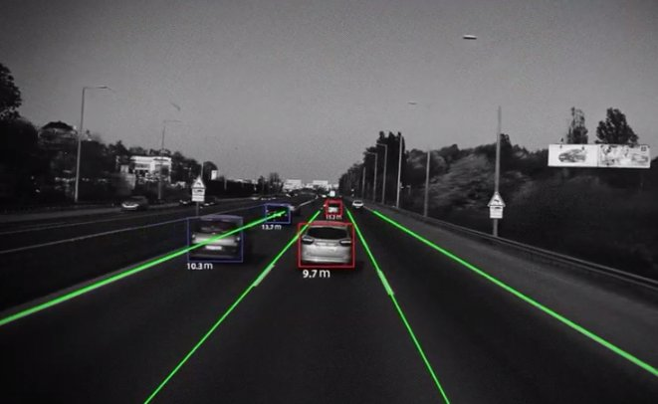
动机| Motivation
各种各样的系统协同工作:
雷达和激光
运动传感器
计算机视觉
图像处理
神经网络预测
Google
Mobileye
Notes:
(CLICK) Currently there are a number of different systems - usually integrated - that can enable a car to drive itself.
These include:
Radar and Lidar
Motion sensors
and Computer Vision.
(CLICK)
My project focused only on Computer Vision, and specifically two techniques: IMAGE PROCESSING and NEURAL NETWORKS

Slide 4
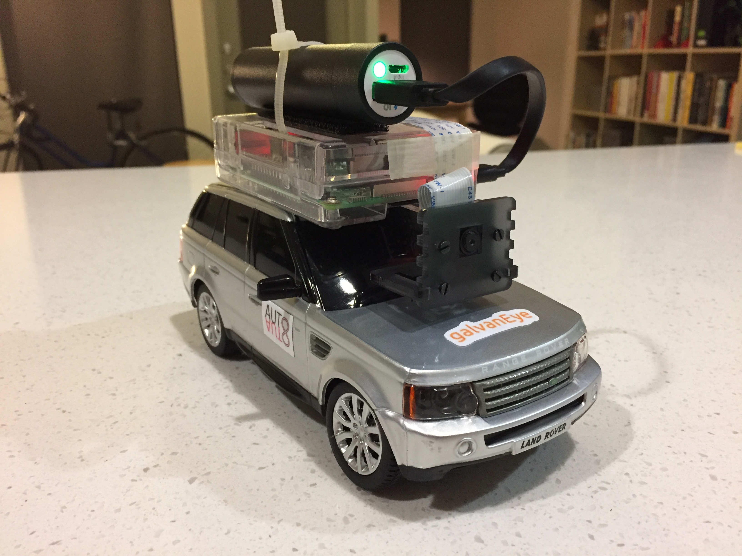
模型|MODEL
移动电源
Raspberry Pi 3
摄像头模块
RC车
Goals:
自动驾驶
检测
Stop signs
Traffic light
Notes:
I didn’t have access to an actual self-driving car, (CLICK) so working with an RC car was the next best thing.
(CLICK)
MY GOALS FOR THIS PROJECT were to train the car to drive itself and to detect common environmental variables, like stop signs and pedestrians.

Slide 5
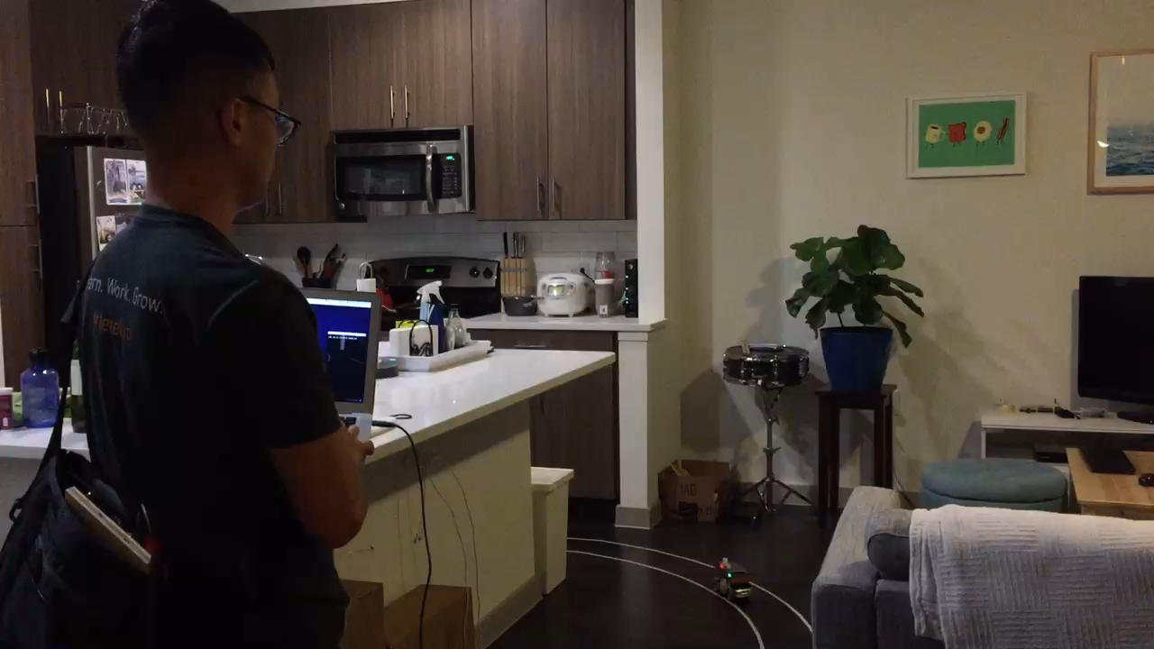
模型： 训练数据 | Model: Training data
Notes:
That’s me in my apartment, collecting data by driving the car with my computer on a test track encircling my kitchen.
Every time the car moves, it’s capturing an image of the road in front of it, along with the direction I told it to move at that instance.

Slide 6
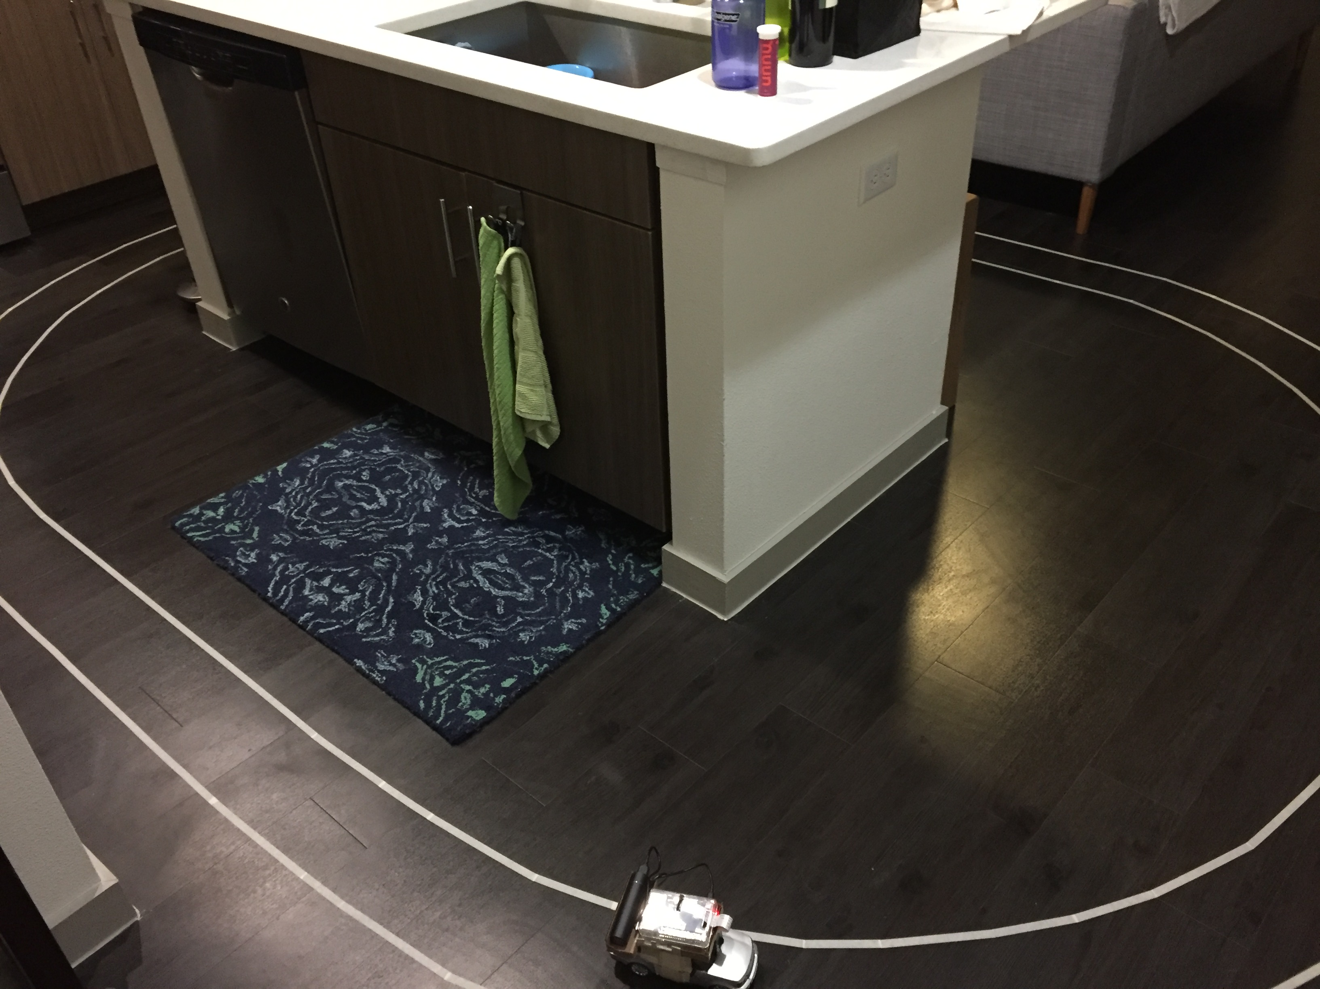
模型： 训练数据 | Model: Training data
Notes:
I collected over 5,000 data points in this manner, which took about ten hours over the course of three days.
Here’s a wider view of the test track.

Slide 7
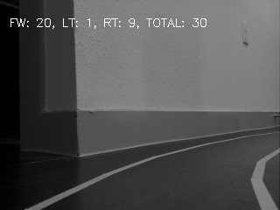

模型： 训练 | Model: Training
Notes:
This is an example of one of those frames taken by the car.
(CLICK) To reduce the load for image processing, the top half is cut off because it’s irrelevant for the task of driving.

Slide 8
模型： 训练 | Model: Training
“LEFT”
[1, 0, 0]
“RIGHT”
[0, 1, 0]
“FORWARD”
[0, 0, 1]
Given this image as input, the correct output is to turn “RIGHT”.
320 px
120 px
Notes:
The resulting image is only 120 by 320 pixels. (PAUSE)
And this part is really the CRUX of teaching the model how to drive:
Because when I pressed the RIGHT ARROW key here, I basically told the model (CLICK) : “When you see something like this, you should turn RIGHT”
(CLICK) Each direction I gave the model was encoded as a binary value that could be interpreted as target outputs for the model.

Slide 9
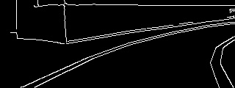
模型： 训练 | Model: Training
“RIGHT”
[0, 1, 0]
Given this image as input, the correct output is to turn “RIGHT”.
320 px
120 px
Notes:
Also to make things easier, a Canny filter was applied to only detect edges and ignore everything else.

Slide 10
模型： 训练 | Model: Training
“RIGHT”
[0, 1, 0]
Given this image as input, the correct output is to turn “RIGHT”.
320 px
NOISE
120 px
SIGNAL
Notes:
In image processing, there is always SIGNAL and NOISE.
(CLICK) We want the neural net to learn the SIGNAL, which in this case is the right-ward curvature of the road.
(CLICK) And we want it to ignore the NOISE.

Slide 11
模型： 训练 | Model: Training
“RIGHT”
[0, 1, 0]
(not drawn to scale)
[[255, 0, 255, 0, 0, 0, 0, 0, 0, 0, 0],
[255, 0, 255, 0, 0, 0, 0, 255, 255, 255, 255],
[255, 0, 255, 0, 255, 255, 255, 0, 0, 0, 0],
[255, 255, 255, 255, 0, 0, 0, 0, 0, 255, 255],
[ 0, 0, 0, 0, 0, 0, 0, 255, 255, 0, 0],
[ 0, 0, 0, 0, 0, 255, 255, 0, 0, 0, 0],
[ 0, 0, 0, 0, 255, 0, 0, 0, 0, 0, 255],
[ 0, 0, 0, 255, 0, 0, 0, 0, 0, 0, 255],
[ 0, 0, 255, 0, 0, 0, 0, 0, 0, 0, 255],
[ 0, 255, 0, 0, 0, 0, 0, 0, 0, 255, 0],
[255, 0, 0, 0, 0, 0, 0, 0, 0, 255, 0]]
Notes:
When a computer processes an image, it’s actually working with a matrix of numbers representing pixel values. Here’s a simplified matrix for the image we just saw.
To reduce the dimensions, this 2-D matrix is “flattened” into one long array with 38,400 elements.

Slide 12
模型： 训练 | Model: Training
“RIGHT”
[0, 1, 0]
120 x 320 = 38,400
(not drawn to scale)
320 px
[[255, 0, 255, 0, 0, 0, 0, 0, 0, 0, 0],
[255, 0, 255, 0, 0, 0, 0, 255, 255, 255, 255],
[255, 0, 255, 0, 255, 255, 255, 0, 0, 0, 0],
[255, 255, 255, 255, 0, 0, 0, 0, 0, 255, 255],
[ 0, 0, 0, 0, 0, 0, 0, 255, 255, 0, 0],
120 px
[ 0, 0, 0, 0, 0, 255, 255, 0, 0, 0, 0],
[ 0, 0, 0, 0, 255, 0, 0, 0, 0, 0, 255],
[ 0, 0, 0, 255, 0, 0, 0, 0, 0, 0, 255],
[ 0, 0, 255, 0, 0, 0, 0, 0, 0, 0, 255],
[ 0, 255, 0, 0, 0, 0, 0, 0, 0, 255, 0],
[255, 0, 0, 0, 0, 0, 0, 0, 0, 255, 0]]

Slide 13
模型： 训练 | Model: Training
“RIGHT”
[0, 1, 0]
120 x 320 = 38,400
[[255, 0, 255, 0, 0, 0, 0, 0, 0, 0, 0],
[255, 0, 255, 0, 0, 0, 0, 255, 255, 255, 255],
[255, 0, 255, 0, 255, 255, 255, 0, 0, 0, 0],
[255, 255, 255, 255, 0, 0, 0, 0, 0, 255, 255],
[ 0, 0, 0, 0, 0, 0, 0, 255, 255, 0, 0],
[ 0, 0, 0, 0, 0, 255, 255, 0, 0, 0, 0],
[ 0, 0, 0, 0, 255, 0, 0, 0, 0, 0, 255],
[ 0, 0, 0, 255, 0, 0, 0, 0, 0, 0, 255],
[ 0, 0, 255, 0, 0, 0, 0, 0, 0, 0, 255],
[ 0, 255, 0, 0, 0, 0, 0, 0, 0, 255, 0],
[255, 0, 0, 0, 0, 0, 0, 0, 0, 255, 0]]

Slide 14
模型： 训练 | Model: Training
“RIGHT”
[0, 1, 0]
120 x 320 = 38,400
[[255, 0, 255, 0, 0, 0, 0, 0, 0, 0, 0],
[255, 0, 255, 0, 0, 0, 0, 255, 255, 255, 255],
[255, 0, 255, 0, 255, 255, 255, 0, 0, 0, 0],
[255, 255, 255, 255, 0, 0, 0, 0, 0, 255, 255],
[ 0, 0, 0, 0, 0, 0, 0, 255, 255, 0, 0],
[ 0, 0, 0, 0, 0, 255, 255, 0, 0, 0, 0],
[ 0, 0, 0, 0, 255, 0, 0, 0, 0, 0, 255],
[ 0, 0, 0, 255, 0, 0, 0, 0, 0, 0, 255],
[ 0, 0, 255, 0, 0, 0, 0, 0, 0, 0, 255],
[ 0, 255, 0, 0, 0, 0, 0, 0, 0, 255, 0],
[255, 0, 0, 0, 0, 0, 0, 0, 0, 255, 0]]

Slide 15
模型： 训练 | Model: Training
“RIGHT”
[0, 1, 0]
120 x 320 = 38,400
[ 0, 0, 0, 0, 0, 0, 0, 0, 0, 0, 0],
[255, 0, 0, 0, 0, 0, 0, 0, 0, 255, 0]]
[ 0, 255, 0, 0, 0, 0, 0, 0, 0, 255, 0],
[ 0, 0, 0, 0, 0, 0, 0, 0, 0, 0, 0],
[ 0, 0, 0, 0, 0, 0, 0, 255, 255, 0, 0],
[ 0, 0, 0, 0, 255, 0, 0, 0, 0, 0, 255],
[ 0, 0, 255, 0, 0, 0, 0, 0, 0, 0, 255],
[[ 0, 0, 0, 0, 0, 0, 0, 0, 0, 0, 0],
[ 0, 0, 0, 0, 0, 0, 0, 0, 0, 255, 255],
[ 0, 0, 0, 0, 0, 255, 255, 0, 0, 0, 0],
[ 0, 0, 0, 255, 0, 0, 0, 0, 0, 0, 255],

Slide 16
模型： 训练 | Model: Training
“RIGHT”
[0, 1, 0]
[ 0, 0, 0, 0, 0, 0, 0, 0, 0, 0, 0],
[255, 0, 0, 0, 0, 0, 0, 0, 0, 255, 0]]
[ 0, 255, 0, 0, 0, 0, 0, 0, 0, 255, 0],
[ 0, 0, 0, 0, 0, 0, 0, 0, 0, 0, 0],
[ 0, 0, 0, 0, 0, 0, 0, 255, 255, 0, 0],
[ 0, 0, 0, 0, 255, 0, 0, 0, 0, 0, 255],
[ 0, 0, 255, 0, 0, 0, 0, 0, 0, 0, 255],
[[ 0, 0, 0, 0, 0, 0, 0, 0, 0, 0, 0],
[ 0, 0, 0, 0, 0, 0, 0, 0, 0, 255, 255],
[ 0, 0, 0, 0, 0, 255, 255, 0, 0, 0, 0],
[ 0, 0, 0, 255, 0, 0, 0, 0, 0, 0, 255],

Slide 17
模型： 训练 | Model: Training
“RIGHT”
[0, 1, 0]
[ 0, 0, 0, 0, 0, 0, 0, 0, 0, 0, 0],
[255, 0, 0, 0, 0, 0, 0, 0, 0, 255, 0]]
[ 0, 255, 0, 0, 0, 0, 0, 0, 0, 255, 0],
[ 0, 0, 0, 0, 0, 0, 0, 0, 0, 0, 0],
[ 0, 0, 0, 0, 0, 0, 0, 255, 255, 0, 0],
[ 0, 0, 0, 0, 255, 0, 0, 0, 0, 0, 255],
[ 0, 0, 255, 0, 0, 0, 0, 0, 0, 0, 255],
[[ 0, 0, 0, 0, 0, 0, 0, 0, 0, 0, 0],
[ 0, 0, 0, 0, 0, 0, 0, 0, 0, 255, 255],
[ 0, 0, 0, 0, 0, 255, 255, 0, 0, 0, 0],
[ 0, 0, 0, 255, 0, 0, 0, 0, 0, 0, 255],

Slide 18
模型： 训练 | Model: Training
“RIGHT”
[0, 1, 0]
[ 0, 0, 0, 0, 0, 0, 0, 0, 0, 0, 0],
[255, 0, 0, 0, 0, 0, 0, 0, 0, 255, 0]]
[ 0, 255, 0, 0, 0, 0, 0, 0, 0, 255, 0],
[ 0, 0, 0, 0, 0, 0, 0, 0, 0, 0, 0],
[ 0, 0, 0, 0, 0, 0, 0, 255, 255, 0, 0],
[ 0, 0, 0, 0, 255, 0, 0, 0, 0, 0, 255],
[ 0, 0, 255, 0, 0, 0, 0, 0, 0, 0, 255],
[[ 0, 0, 0, 0, 0, 0, 0, 0, 0, 0, 0],
[ 0, 0, 0, 0, 0, 0, 0, 0, 0, 255, 255],
[ 0, 0, 0, 0, 0, 255, 255, 0, 0, 0, 0],
[ 0, 0, 0, 255, 0, 0, 0, 0, 0, 0, 255],

Slide 19
模型： 训练 | Model: Training
“RIGHT”
[0, 1, 0]
[ 0, 0, 0, 0, 0, 0, 0, 0, 0, 0, 0],
[255, 0, 0, 0, 0, 0, 0, 0, 0, 255, 0]]
[ 0, 255, 0, 0, 0, 0, 0, 0, 0, 255, 0],
[ 0, 0, 0, 0, 0, 0, 0, 0, 0, 0, 0],
[ 0, 0, 0, 0, 0, 0, 0, 255, 255, 0, 0],
[ 0, 0, 0, 0, 255, 0, 0, 0, 0, 0, 255],
[ 0, 0, 255, 0, 0, 0, 0, 0, 0, 0, 255],
[[ 0, 0, 0, 0, 0, 0, 0, 0, 0, 0, 0],
[ 0, 0, 0, 0, 0, 0, 0, 0, 0, 255, 255],
[ 0, 0, 0, 0, 0, 255, 255, 0, 0, 0, 0],
[ 0, 0, 0, 255, 0, 0, 0, 0, 0, 0, 255],

Slide 20
模型： 训练 | Model: Training
“RIGHT”
[0, 1, 0]
[ 0, 0, 0, 0, 0, 0, 0, 0, 0, 0, 0],
[ 0, 0, 0, 0, 0, 0, 0, 0, 0, 0, 0],
[ 0, 0, 0, 0, 0, 0, 0, 255, 255, 0, 0],
[ 0, 0, 0, 0, 255, 0, 0, 0, 0, 0, 255],
[[ 0, 0, 0, 0, 0, 0, 0, 0, 0, 0, 0],
[ 0, 0, 0, 0, 0, 0, 0, 0, 0, 255, 255],
[ 0, 0, 0, 0, 0, 255, 255, 0, 0, 0, 0],
[ 0, 0, 0, 255, 0, 0, 0, 0, 0, 0, 255],

Slide 21
模型： 训练 | Model: Training
INPUT LAYER 38,400 nodes
HIDDEN LAYER 30 nodes
“RIGHT”
[0, 1, 0]
OUTPUT LAYER 3 nodes
[1, 0, 0]
“LEFT”
[ 0, 0, 0, 0, 0, 0, 0, 0, 0, 0, 0],
[ 0, 0, 0, 0, 0, 0, 0, 0, 0, 0, 0],
[ 0, 0, 0, 0, 0, 0, 0, 255, 255, 0, 0],
[ 0, 0, 0, 0, 255, 0, 0, 0, 0, 0, 255],
[[ 0, 0, 0, 0, 0, 0, 0, 0, 0, 0, 0],
[ 0, 0, 0, 0, 0, 0, 0, 0, 0, 255, 255],
[ 0, 0, 0, 0, 0, 255, 255, 0, 0, 0, 0],
[ 0, 0, 0, 255, 0, 0, 0, 0, 0, 0, 255],
38,400 features
[0, 1, 0]
“RIGHT”
[0, 0, 1]
“FORWARD”
Notes:
That long array representing the image is then fed into the layers of the neural network,
(CLICK) That image array is then PAIRED with the correct output value of “TURN RIGHT”.
With enough training examples like this, the model eventually learns which images represent “Left, Right, and Forward”.
The best model I trained achieved an ACCURACY of about 81% on cross-validation, and this was the one I used to have the car drive itself.

Slide 22
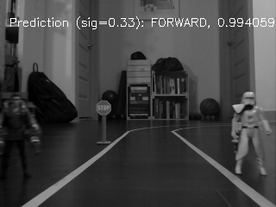
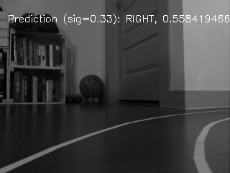
表现：驾驶 | Performance: Driving
Notes:
(CLICK) On the left, we see a correct prediction for FORWARD, of which the model is very sure – at this moment – that it’s making the right decision.
(CLICK) On the right, we get a correct prediction for a RIGHT turn, but at a lower confidence.

Slide 23
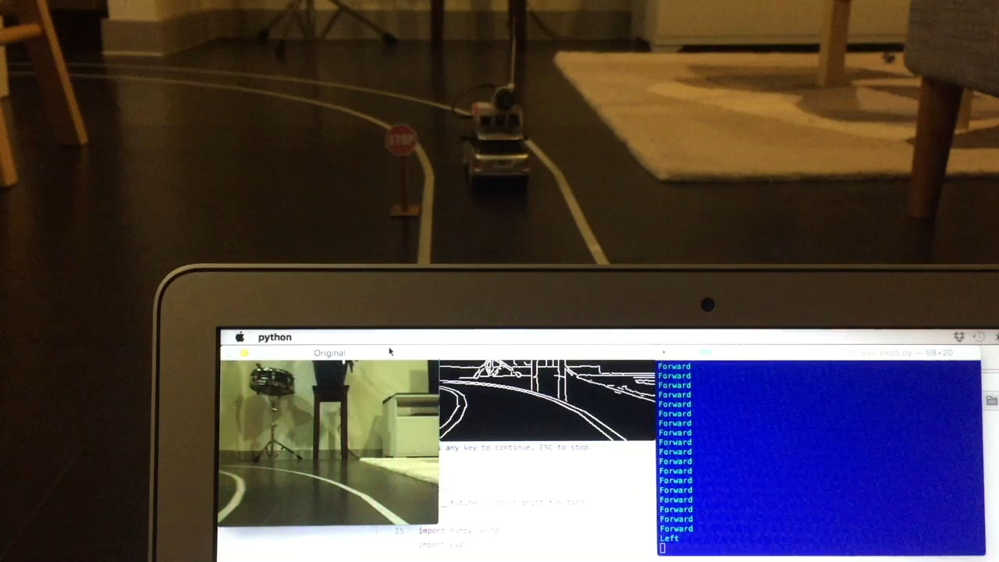
表现：驾驶 | Performance: Driving
Notes:
In the “real world” of my kitchen, MY best model can drive the car while making only about 1 mistake per lap.
A mistake can be defined as: Driving completely outside of the lines without being able to find its way back.

Slide 24
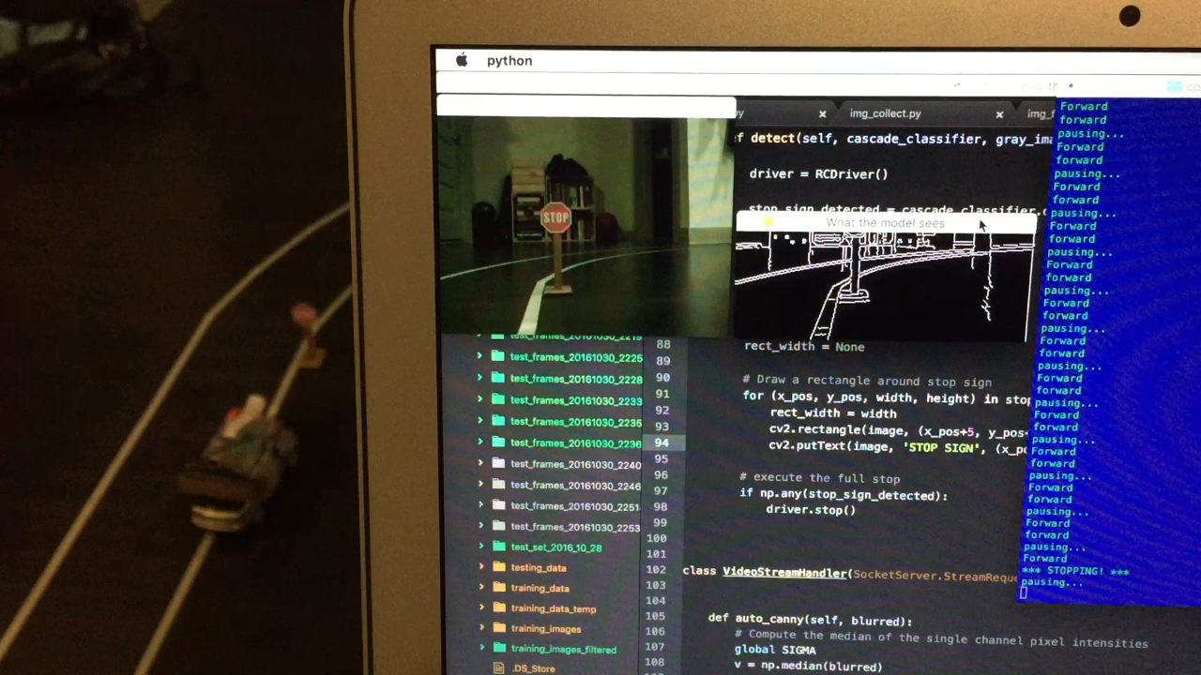
表现：STOP标志和红绿灯检测 | Performance: Driving: Stop sign and Traffic lights detection
Notes:
I trained a Haar Cascade Classifier to have the program recognize Stop signs.
And I incorporated Pedestrian detection using a pre-trained HOG-SVM model in OpenCV. Here it successfully detected two Star Wars characters as pedestrians.

Slide 25





Packages Used
Image Processing
cv2 (OpenCV v2.4.9)
imutils
Neural Network
keras (TensorFlow backend)
Other
numpy
picamera
pygame
scikit-learn
socket
threading
Notes:
These are the Python packages I used to process images, train the neural network, and tie all of the programming and execution together.

Slide 26

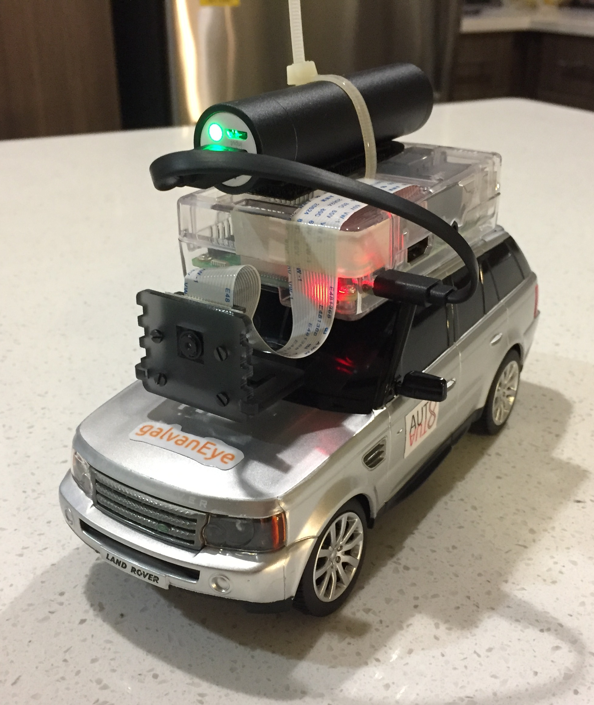
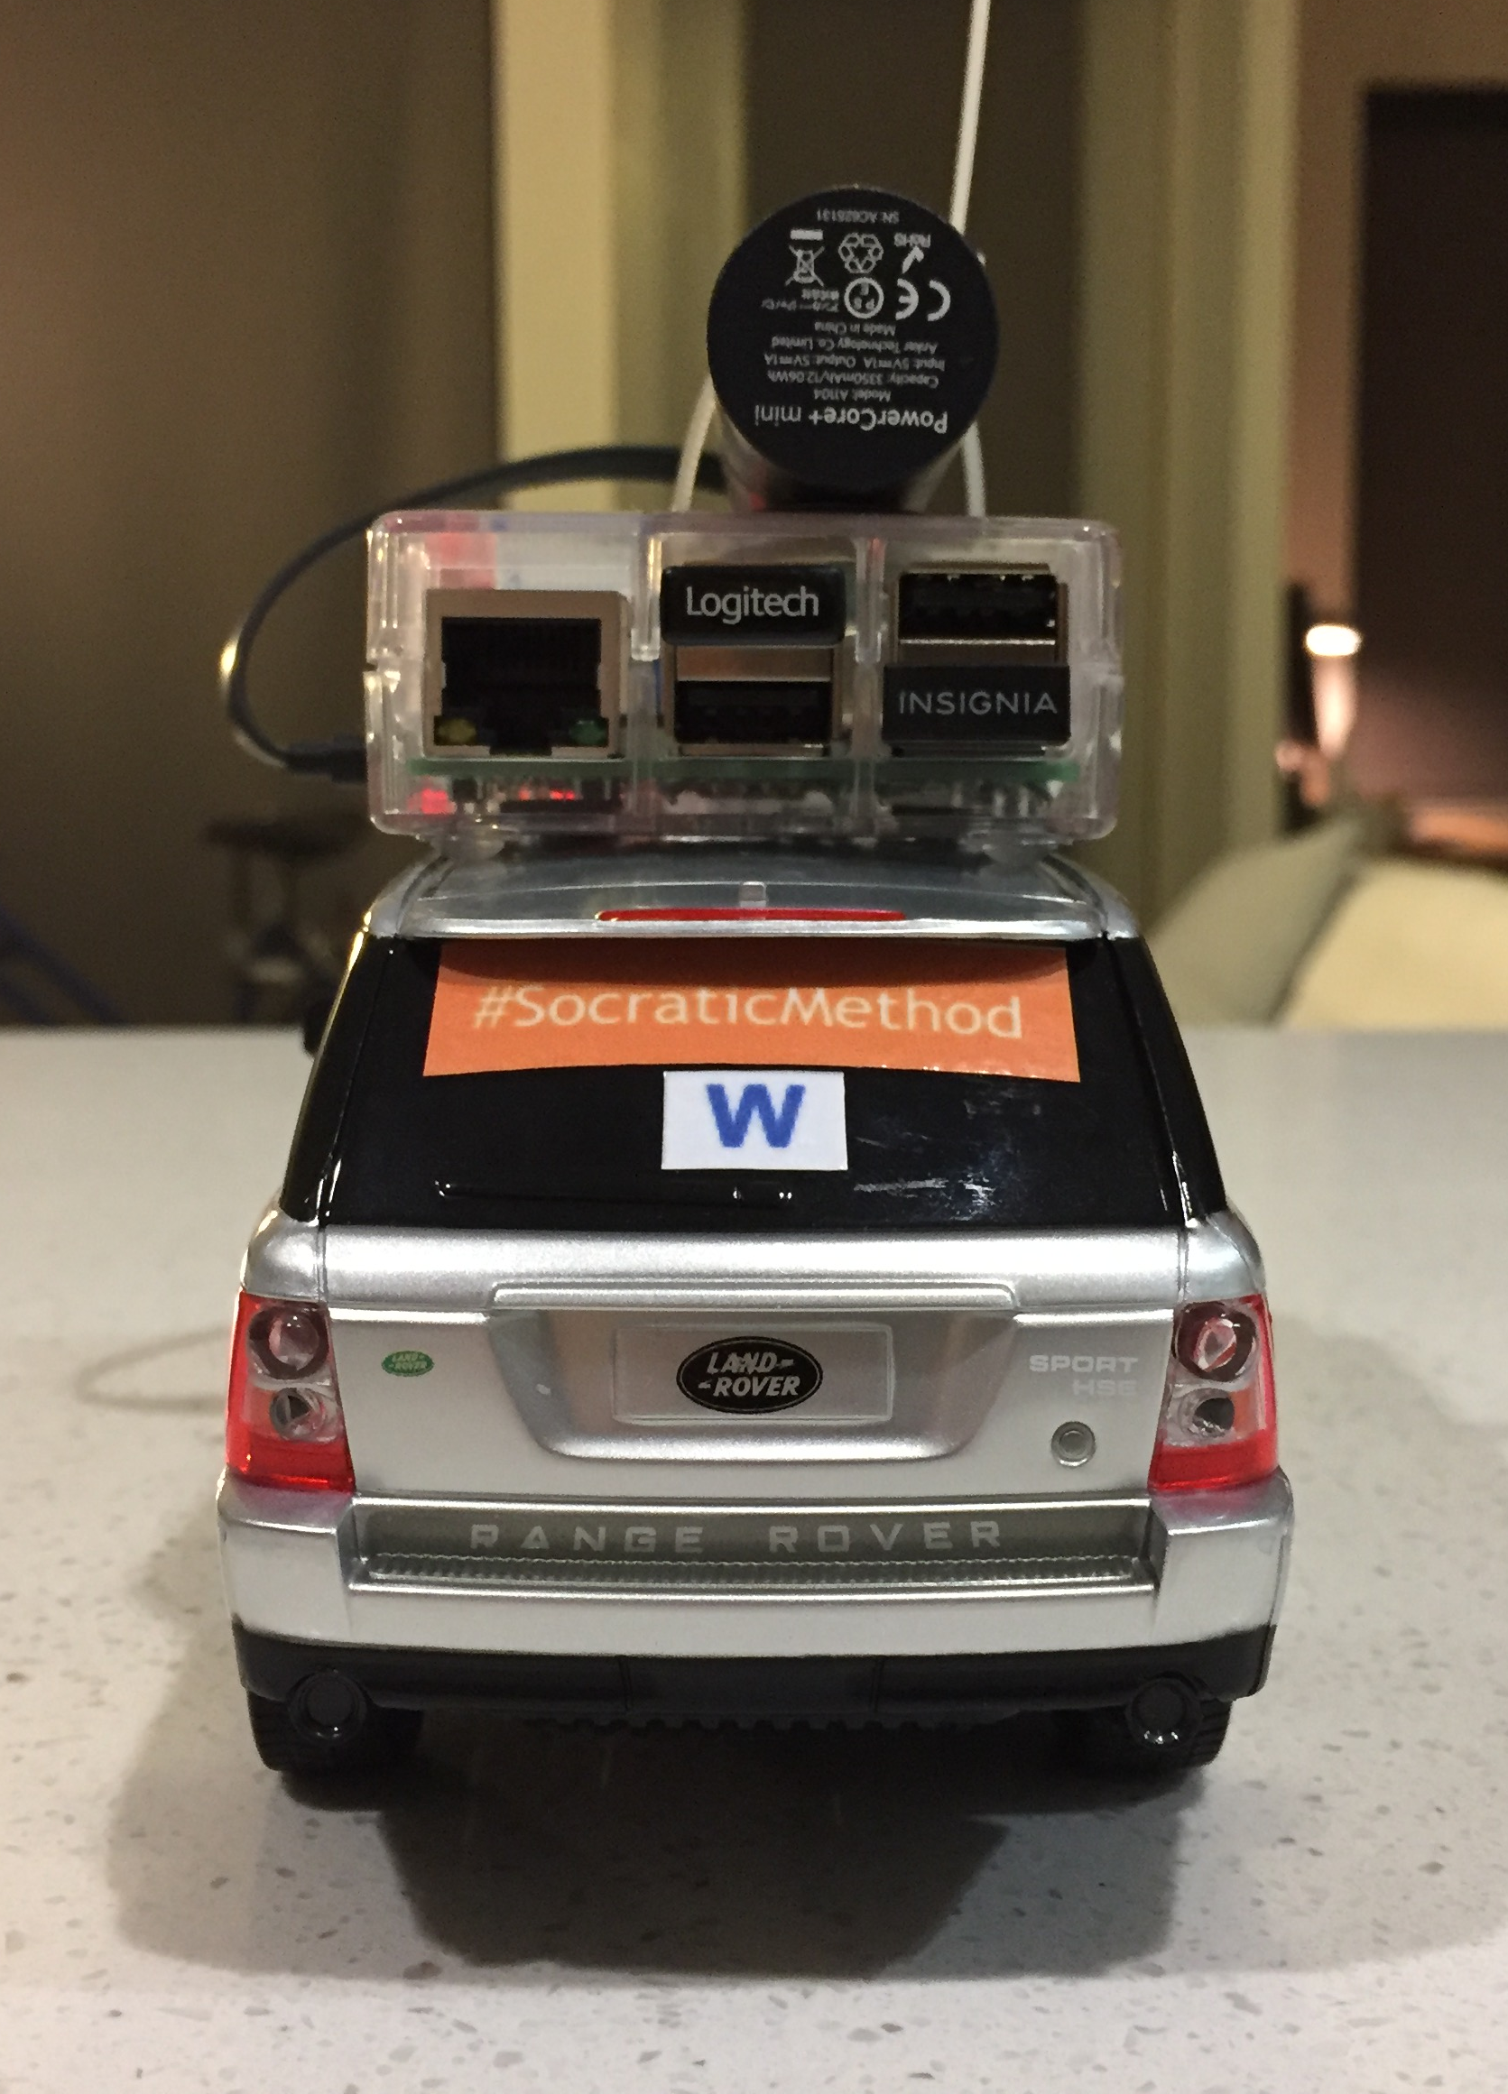
All Code In Bellow:
http://github.com/rh01/Rasp-driving-car
Notes:
I’d like to thank these special people for making all this possible. I learned a ton, and had a lot of fun putting this together.
My brilliant wife, Grace, for teaching me about socket configurations for this project, and for supporting me all these months I’ve been at Galvanize.
AutoAuto, (which Charley mentioned) the hackathon group I’m extremely lucky to be a part of, which accomplished the difficult task of hacking this cheap RC car to be controllable with Python code.
Hamuchiwa, whose own self-driving RC car inspired me to do this project in the first place, and whose Github repo provided invaluable guidance along the way.

Slide 27
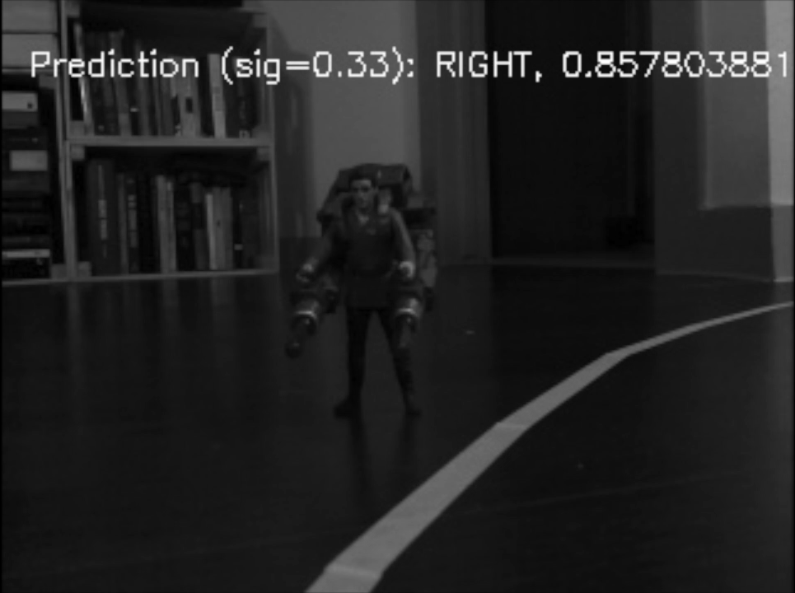


Questions?
1048157315@qq.com
heng960509
rh01

Slide 28
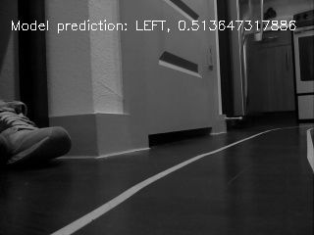
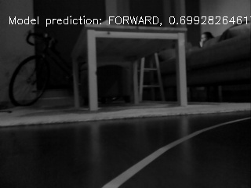
Performance: Driving (Not so good)
Notes:
In some of the cases where the model was wrong, it was almost correct.
(CLICK) In the image on the left, we see the model was nearly 50-50 on which direction to go. It ultimately chose LEFT and wasn’t able to recover.
(CLICK) In the image on the right, the model predicted FORWARD, (CLICK) perhaps because it saw the reflection of the coffee table’s legs on the floor and mistook this for signal.

Slide 29
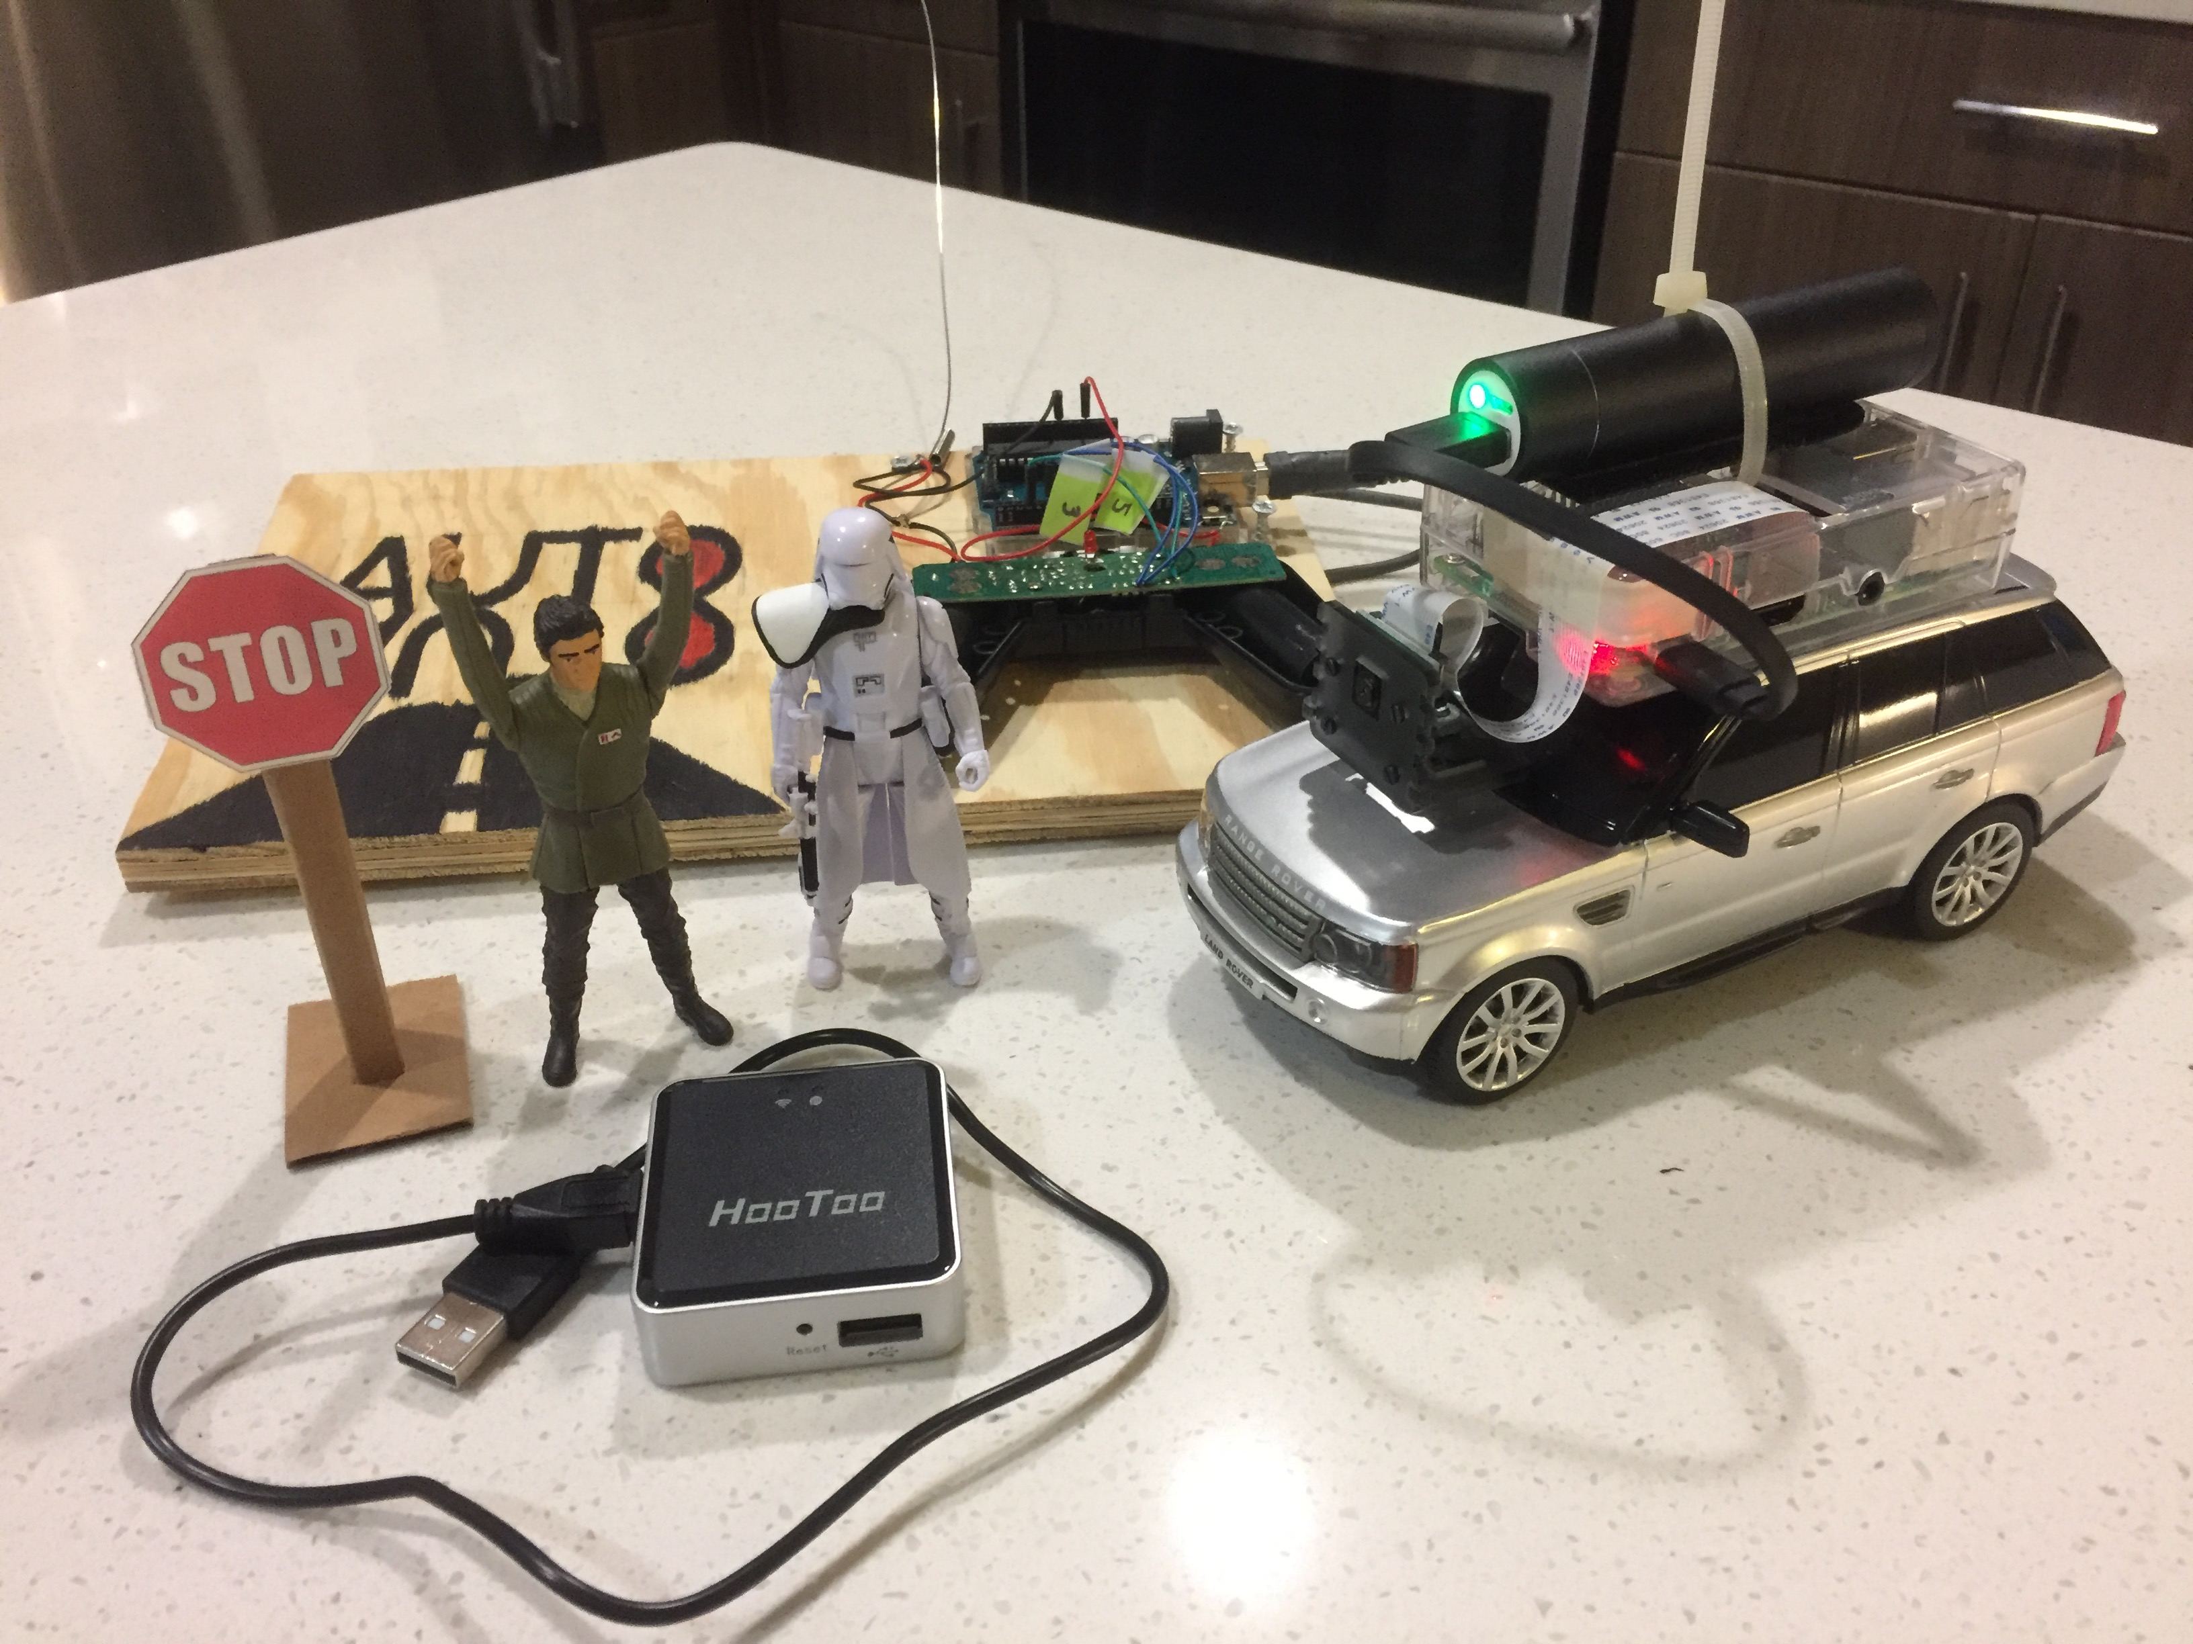
Physical materials (all items sold separately)
Arduino UNO
Action figures!
USB battery charger
Stop sign (homemade)
Raspberry Pi 3, plus camera module
Remote control car
Wireless router

